Slide 1
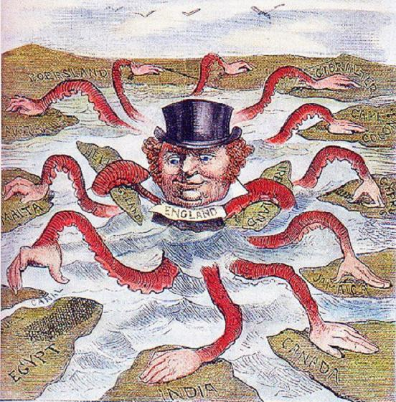

Slide 2
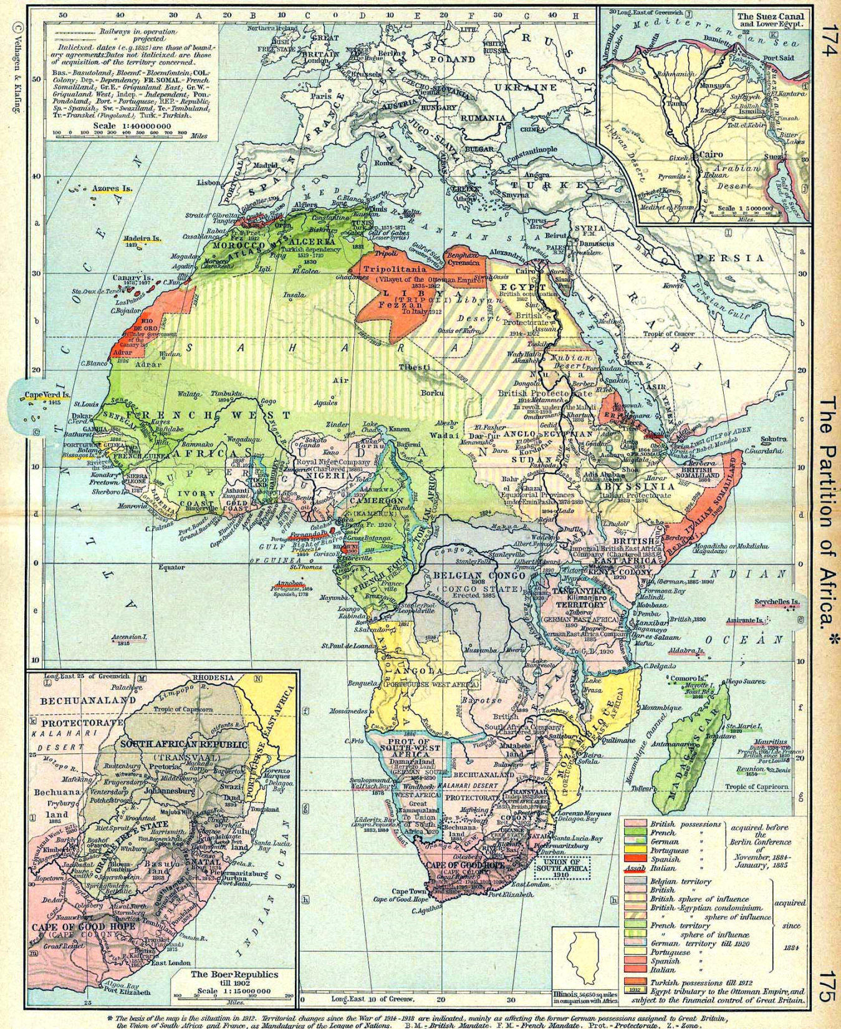

Slide 3
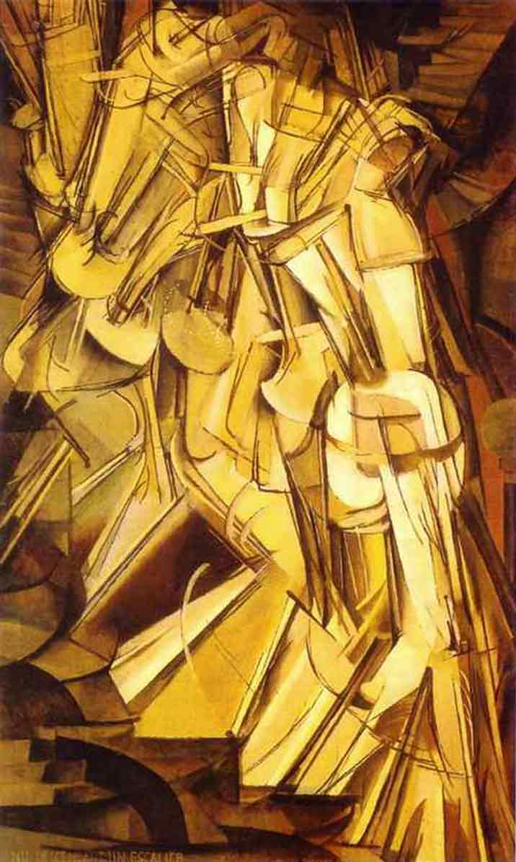
1913 Armory Show, Chicago
$45,000 worth of paintings sold!
Duchamp’s Nude descending a Staircase
(or, explosion in a shingle factory)

Slide 4
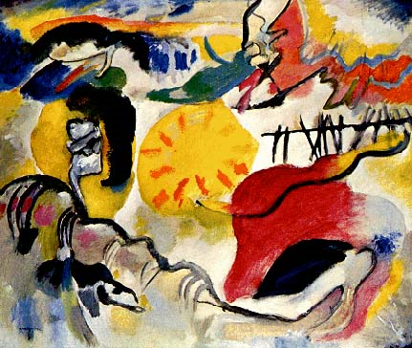
Wassily Kadinsky – Improvisation #27 – Garden of Love

Slide 5

Matisse’s work was chosen by students at Chicago's Art Student's League as the most appalling and blasphemous pictures in the exhibition. The charges brought against him were "artistic murder, pictorial arson, artistic rapine, total degeneracy of color, criminal misuse of line, general aesthetic abberation, and contumacious abuse of title“
Troubled by the public’s reaction to his work, Matisse said in an interview:
"Oh do tell the American people that I am a normal man; that I am a devoted husband and father, that I have three fine children, that I go to the theatre!"
Matisse Goldfish and Sculpture

Slide 6
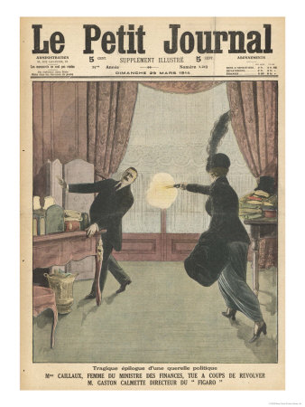
Meanwhile, in Europe, the press had been paying attention to the Caillaux affair. Joseph Caillaux, former premier and current minister of finance and radical socialist leader in France was accused of high crimes and misdemeanors.
His wife was enraged by how the press had destroyed his career. She decided to solve the problem by buying a gun and killing the responsible journalist.
When news arrived of the assassination of the Archduke Franz Ferdinand in Serbia, it seemed only a brief distraction from the Calliaux trial.

Slide 7
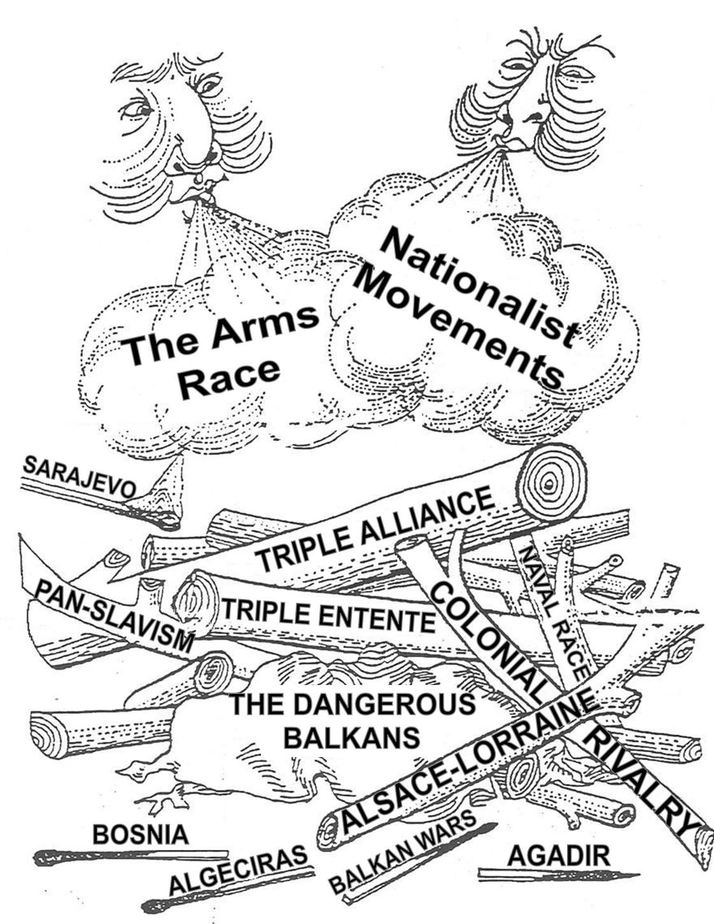

Slide 8
War in Europe
In 1917, the estimated cost of the war was $3.5 billion.
  Actual cost: $35 billion & 50,000 US soldiers.
1917: US Army was the 7th largest in the world. Equipped with old weapons and only had a day and a half of ammunition in reserve.
  Spring, 1917: Army + Nat’l Guard =379,000
  End of War: 4.8 million (3 million draftees)
Early summer, 1917: token American forces
March, 1918: 300,000 Americans in France
November, 1918: over 2 million!
    (1,400,000 of them saw action)
    367,000 African American troops

Slide 9
Woodrow Wilson
Insists on “open door” → to make the world safe for democracy.
1919 – endorses women’s suffrage as vital for winning the war.
Obsessive fear of disloyalty:
  Espionage Act
  Sedition Act
  Selective Service Act
  Trading with the Enemy Act
  Alien Enemies Act
  Alien Act

Slide 10
War Industries Board
Created July, 1917 to determine what materials manufacturers could use and what they could or could not make.
~500 war service committees to oversee and represent industries. (From corsets to steel).
  Price Fixing – US Grain Corp.
  Food Administration – H. Hoover
  Fuel Administration
Labor unions flourished during the war because of high demand for labor.

Slide 11
National War Labor Board
NWLB
To mediate disputes, recognize fair wages and hours, collective bargaining.
War Labor Policies Board
  Set standards for federal employees

Slide 12
World War and the death of Progressive Party
By 1916, Progressives became extremely committed to the defense of national honor, nationalism, and opposition to Wilson. But, imperialism and militarism replaced old liberal formulas of protest, and within a year, the party was dead.
War was justified with progressive rhetoric and on progressive terms.
  Discredited progressive language – morals and ideals
  Guaranteed that anti-war reactions would be anti-progressive.

Slide 13
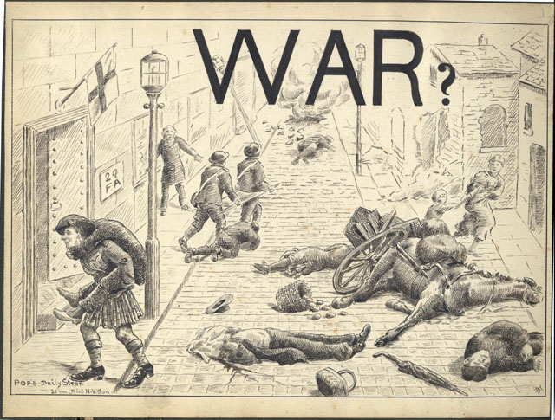
WWI killed 10 million in battle
2 million died of hunger related to war

Slide 14
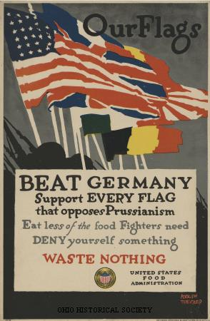
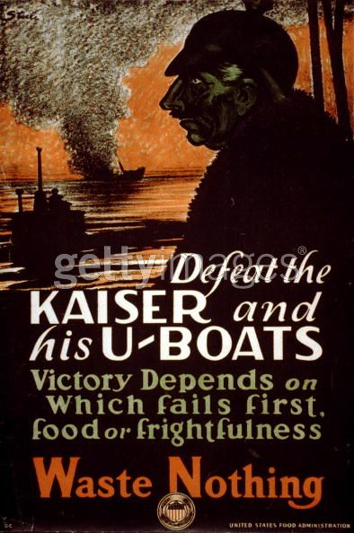

Slide 15
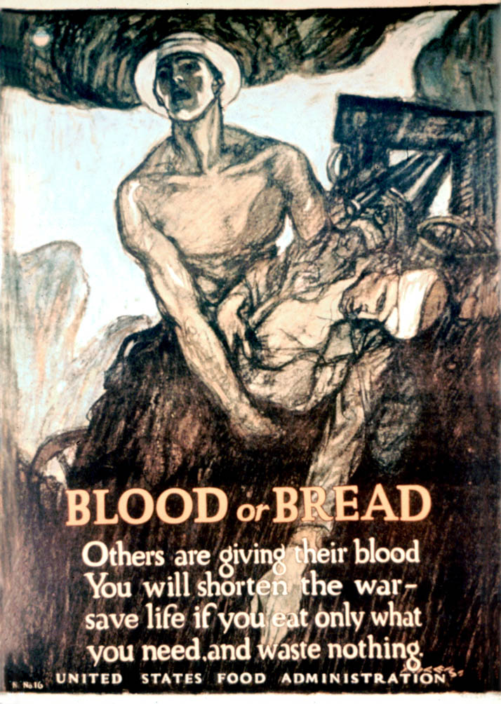
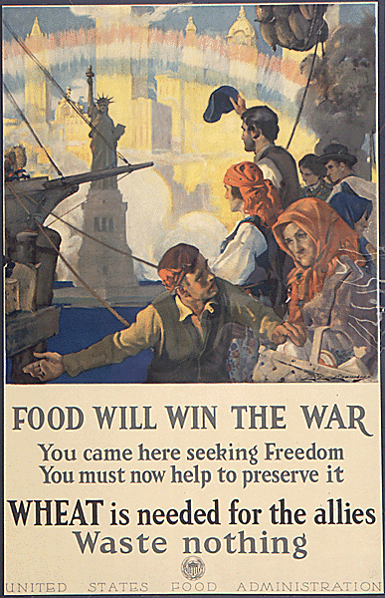

Slide 16
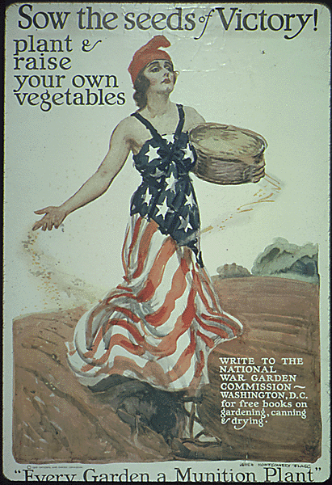
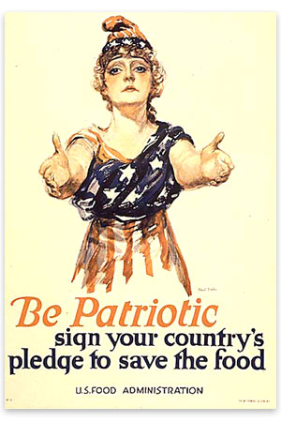
Efforts to save grain led to the 19th Amendment– prohibition.
1915-1918: the real income of farmers grew 30%

Slide 17
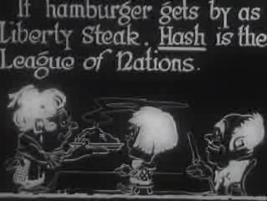

Slide 18
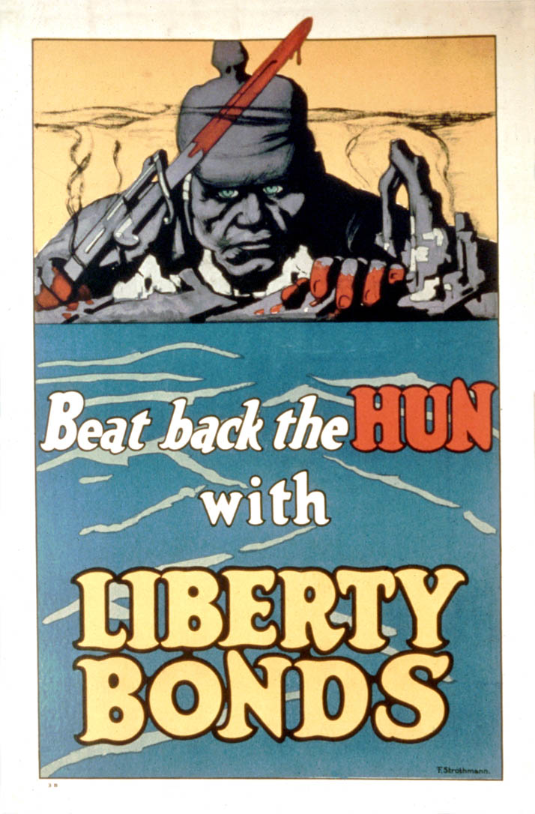
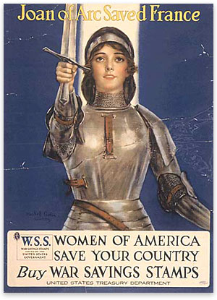
$20 billion were raised with Liberty Bonds

Slide 19
Tax Base
Before the war, most of the government’s revenue came from tariffs.
In 1917, the War Revenue Act was passed, imposing an “excess profits levy” as high as 60%.
  Fed. Revenue went from $930 million in 1916 to $4,388 million in 1918
The personal exemption for income tax went from 3,000 – 1,000
Tax on earnings above $500,000 went from 7% to 77%
  Thus the income tax became the most important source of federal revenues.

Slide 20
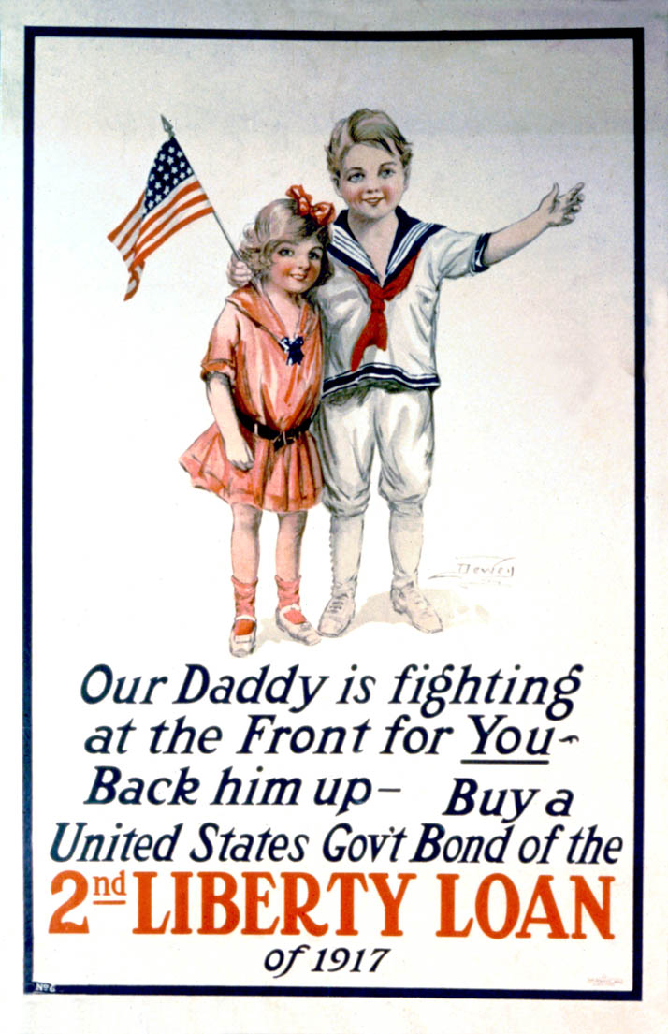
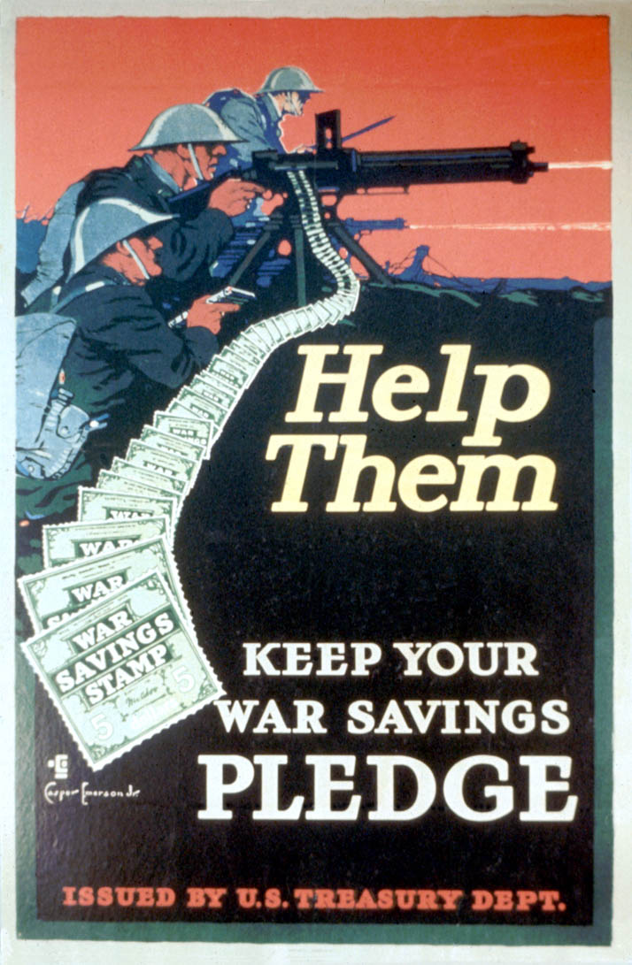

Slide 21
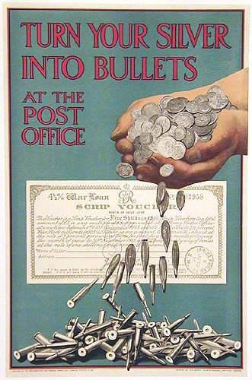

Slide 22
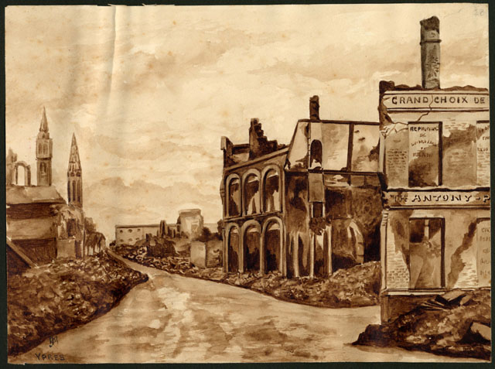

Slide 23
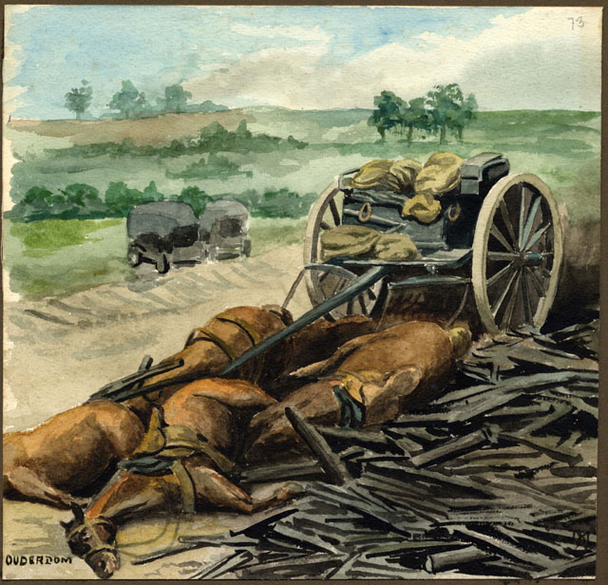

Slide 24
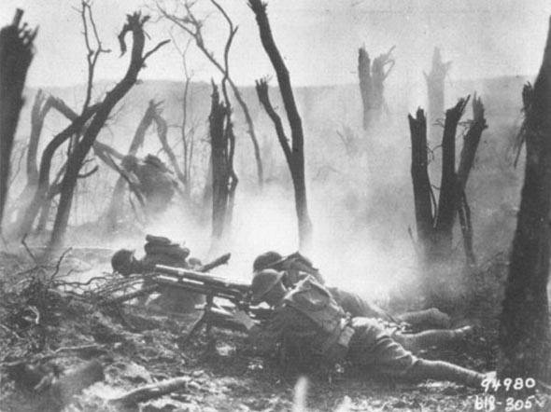

Slide 25
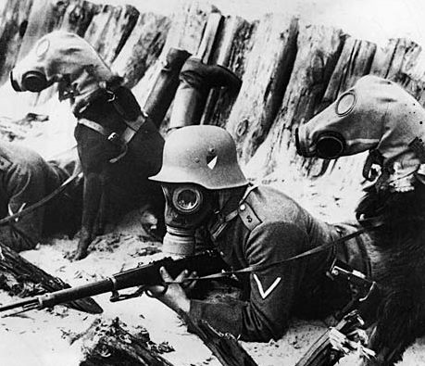

Slide 26
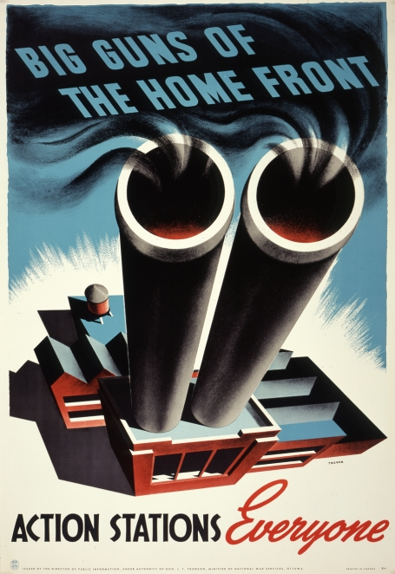
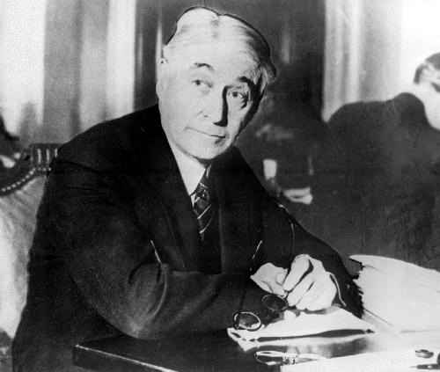
Bernard Baruch, head of the War Industries Board (WIB)

Slide 27
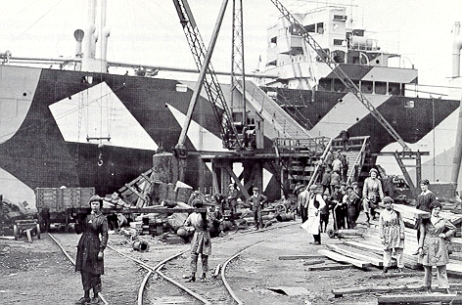

Women working in a shipyard, 1918
1918, the government wanted to encourage women to work on farms to keep food production up.

Slide 28
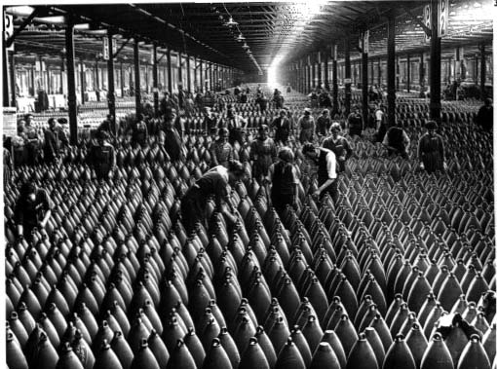
Women in the Workforce

Slide 29
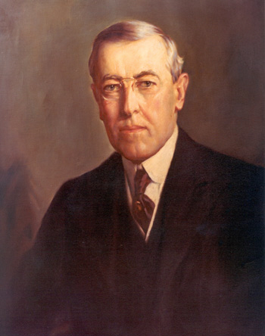
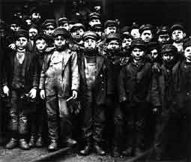
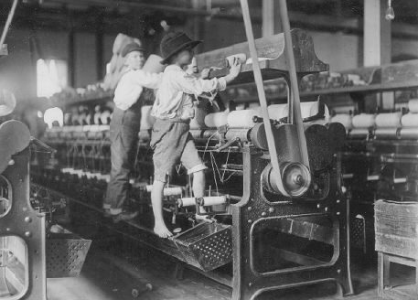
Wartime policies and economic changes wound up killing progressivism, even though progressives were in power. Why do you think?

Slide 30
