Slide 1
STALINISM
Collectivization
The Great Terror
Kulak Actions
National Operations

Slide 2
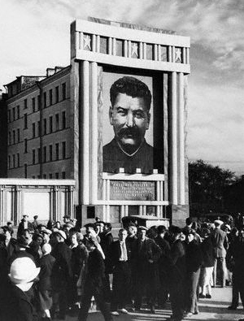
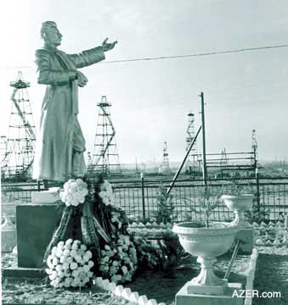

Slide 3
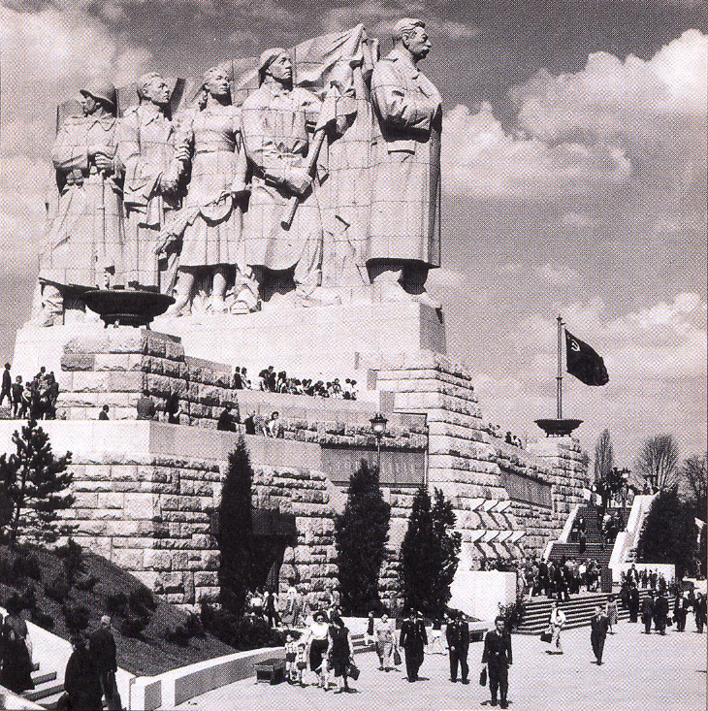

Slide 4
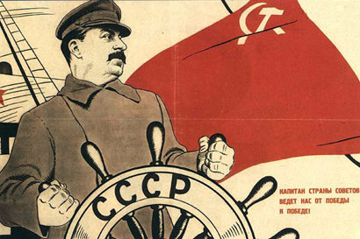

Slide 5
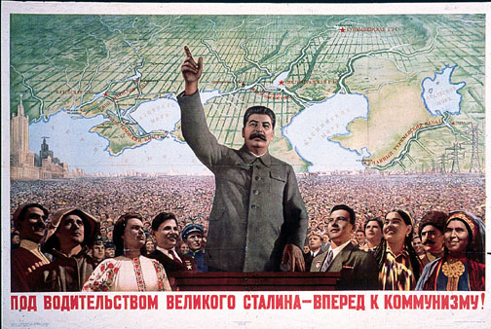

Slide 6
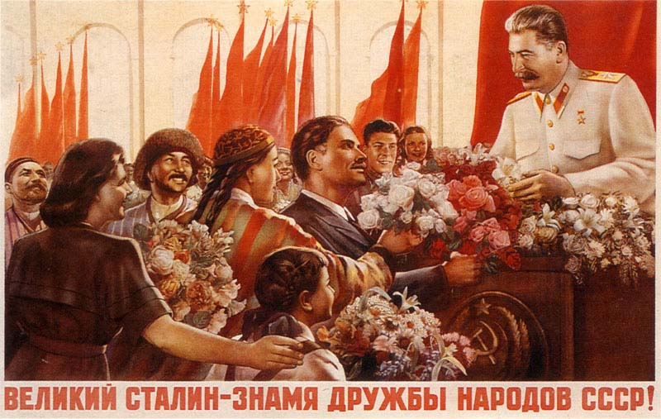

Slide 7
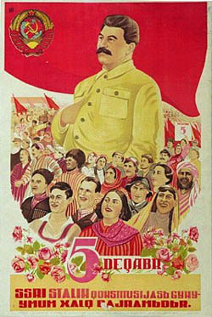
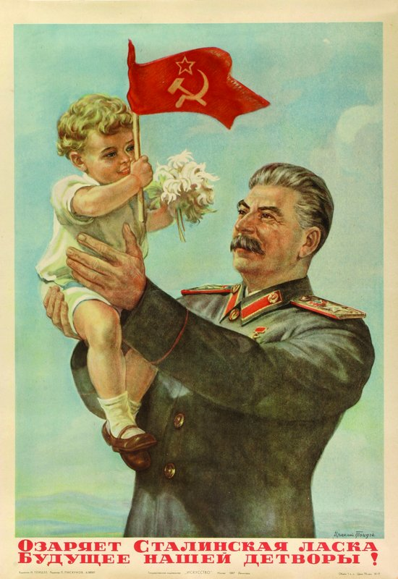

Slide 8
Lenin and the New Economic Policy
Lenin realized that it did not make sense for the state to have complete control over the economy. He allowed capitalism on a small scale: Peasants could use land as if they owned it and could sell their products at market.
Some people did very well: These were called the NEP men.

Slide 9
Collectivization
Stalin takes total control of the economy.
Collectivization of farms = No private property.
  = state decides what is grown, price, distribution
  By getting rid of the landlord class, the theory was that peasants would work harder, be more efficient and production would go up.
What do you think of the idea of collectivization?

Slide 10
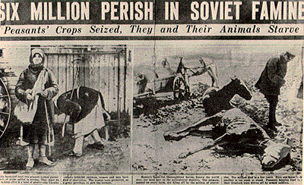

Slide 11
The Great Terror
A system of Purges, based on Quotas
A centralization of power around Stalin
Can be seen as a 3rd Soviet Revolution.
Based on the theory that the enemy can be unmasked only through interrogation.
A Troika would administer trials.
The Great Terror represents the abandonment of Marxism/Leninism and Internationalism.

Slide 12
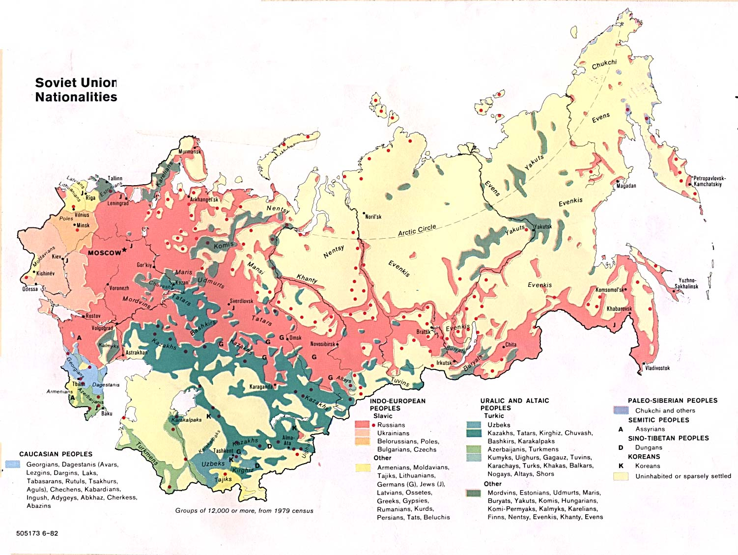

Slide 13
Who would oppose Collectivization?
Peasants who had done well.
  Some peasants had profited under Lenin. These people were called Kulaks, and they stood to lose with Collectivization.
How does Stalin deal with opposition?
Kulak Action was justified by the “Japanese Threat”.
  About 2 million deported to Siberia. About half died.

Slide 14
Who to blame for the failure of Collectivization?
Blame the Polish!!!!
  The Soviets blame the Polish Military Organization (PMO) which hadn’t existed since the 1920s, for having sabotaged collectivization.
  Hundreds of thousands of Poles are arrested and purged from the Ukraine and Belarus.
  The PMO didn’t exist.

Slide 15
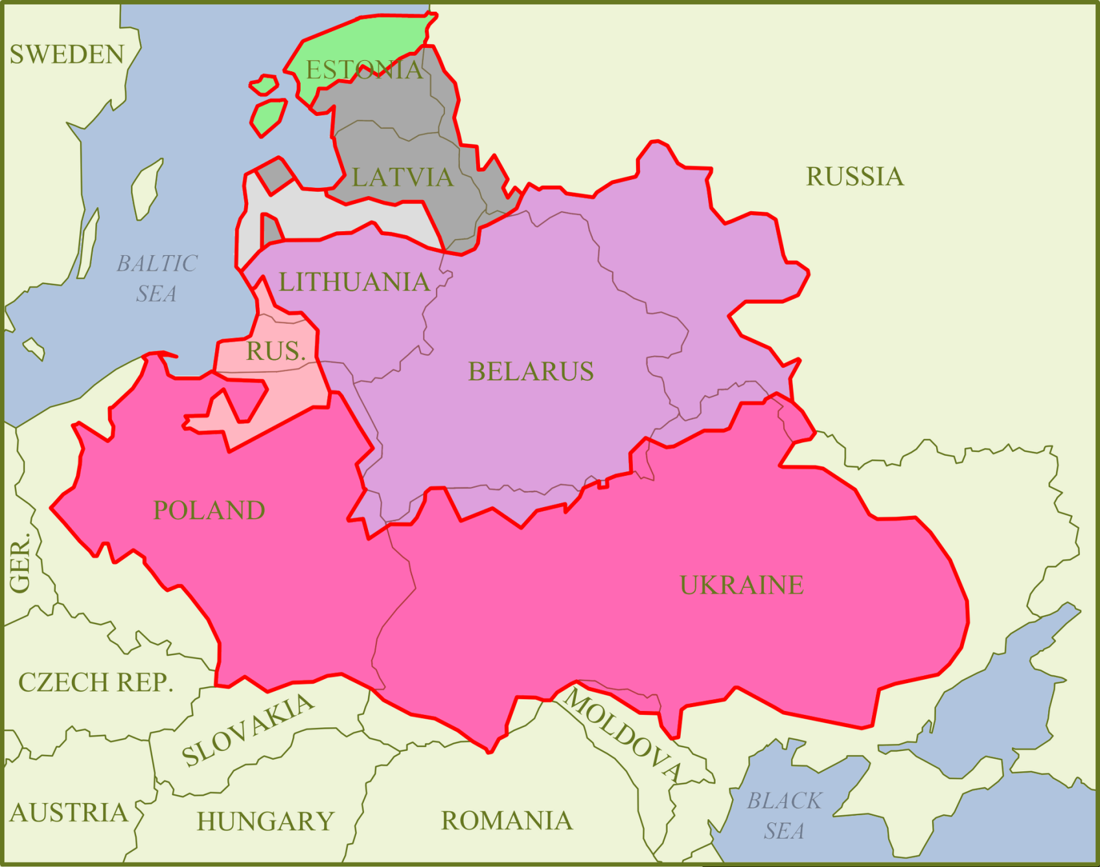
Why there were such large Polish populations in Belarus and the Ukraine:
-- Map of the Kingdom of Poland and the Grand Duchy of Lithuania between 1569 and 1795.

Slide 16
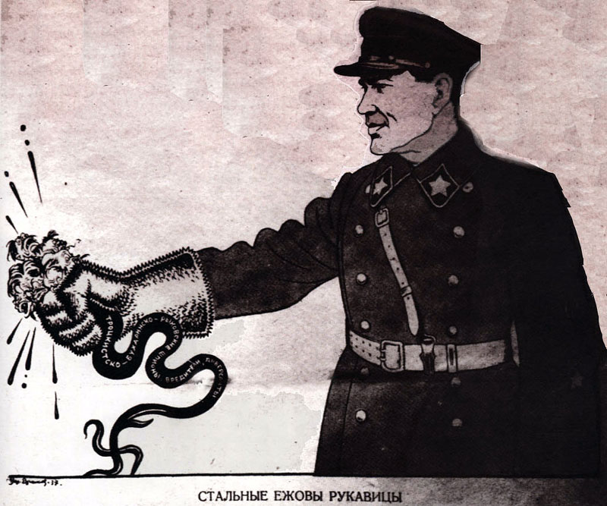
Ezhov’s Iron Glove, 1937
Ezhov was a high-ranking member of the NKVD during the Great Purges.

Slide 17
Polish Action
During the Polish Action: 143,810 arrested and accused of espionage for Poland. 111,000 of those were executed.
Belarus, 1937: 19,931 arrests: 17,772 executed.
Number of Poles in Belarus declines by 60,000 during Great Terror.
Poles were only 0.4% of the total population, but accounted for 1/8 of the victims of the Great Terror. About 682,000 Poles were purged.

Slide 18
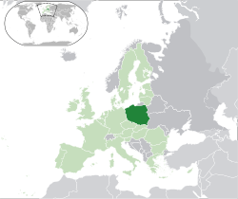
Because of its location between Soviet Russia and Nazi Germany, Poland could not be neutral in any war for eastern Europe. They would either be defeated by the Germans, or ally with them
and attack the
Soviet Union.
Either way, they
were dispensible..

Slide 19
Other National Operations
Latvian, Estonian and Finnish people also fell victim to National operations.
By 1938, the Soviet Union had killed 1,000 times more people on ethnic grounds than Nazi Germany!

Slide 20
Effects of Stalin’s Purges

Slide 21
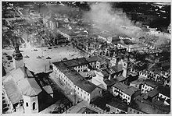
Nazi Germany Invades Poland

Slide 22
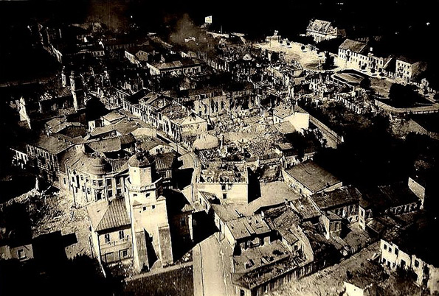
Wielun, 1. September, 1939
Notes:
380 bombs, or about 46 tons of explosive were dropped on Weilun. About 1200 were killed and the town was 75% destroyed.

Slide 23
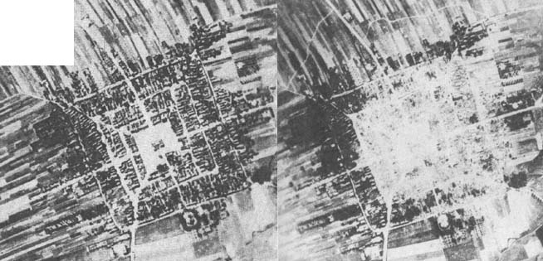
Polish City, Frampol, before and after Luftwaffe attack. 1939.

