Slide 1
South Africa
Apartheid and

Slide 2
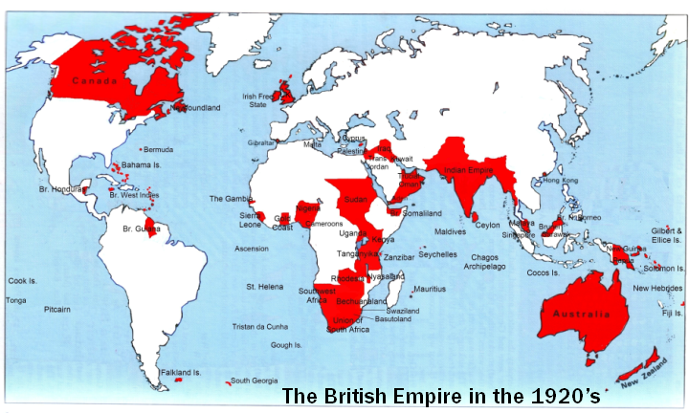
Breakup of the British Empire

Slide 3
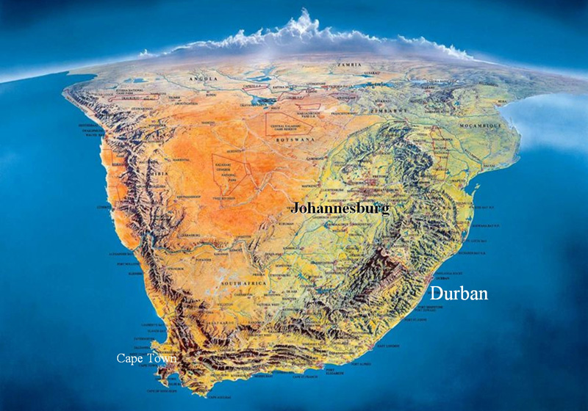
South Africa
Wealthiest country in Africa
    Gold, diamond, coal, uranium mining

Slide 4
Apartheid Laws
In 1948, to strengthen control over South Africa in the face of a weakened British empire, the British and Boer minority enacted apartheid (apartness) laws.
By 1950, the African National Congress (ANC) began a campaign of organized civil disobedience to resist these laws.

Slide 5
Apartheid Laws
Creating reservations or “homelands” for black Africans (~13% of land for about 90% of the population)
  Black Africans couldn’t visit another “homeland” for more than 72 hours without a permit
No intermarriage btw. Whites and blacks
Separate residential areas
pass books: which includes their work, homeland, race. If caught without passbook,arrest and fine were possible.
Education was limited and to be suited the "nature and requirements of the black people". Its aim was to prevent Africans receiving an education that would lead them to aspire to positions they wouldn't be allowed to hold in society.
Restrictions on owning land.
Unequal labor laws
Any African could be detained for successive 90-day periods if suspected of a crime or of having information.

Slide 6
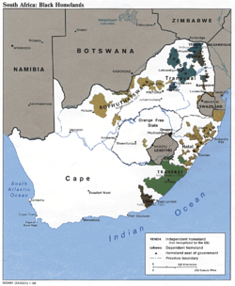
Homelands
Under the homelands system, blacks would no longer be citizens of South Africa; they would instead become citizens of the independent homelands who merely worked in South Africa as foreign migrant
laborers on temporary work
permits.
Many black South Africans
who had never resided in
their identified homeland
were nonetheless forcibly
removed from the cities to
the homelands.

Slide 7
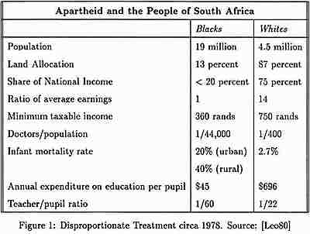

Slide 8
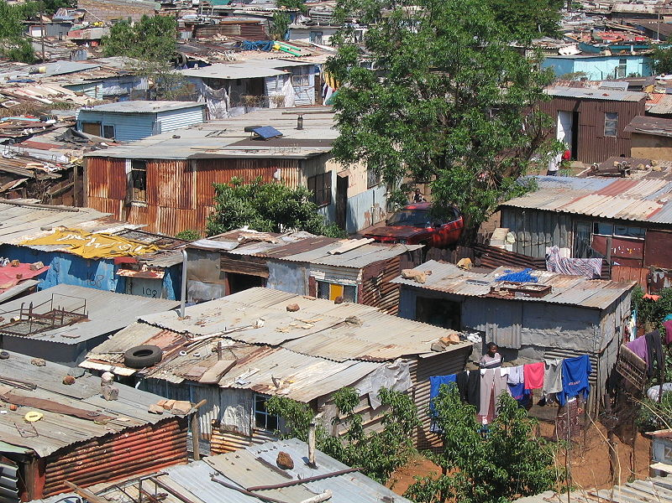
Forced Removals
Black Africans living in cities and outside “homelands” were forcibly removed in the ‘50s, ‘60s and ‘70s.
                In the 1950s, 60,000 people were removed from Johannesburg to form the township of Soweto.

Slide 9
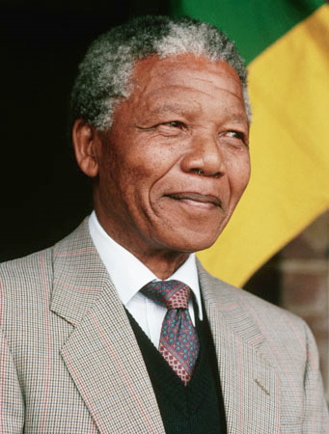
Resistance to Apartheid
The African National Congress (ANC) began a campaign of civil disobedience in the 1950s.
Nelson Mandela
  Involved in the ANC resistance
  to apartheid.
  1960 – ANC is outlawed
  1962 – Mandela is arrested and
  In 1964 was sentenced to life
  In prison for plotting to overthrow
  The gov’t.

Slide 10
Freedom Charter
1955: The African National Congress (ANC) got 50,000 volunteers to go to towns and the countryside to ask people what their “freedom demands” would be for a post apartheid world.

Slide 11
Freedom Charter
Land for the landless
Better working conditions
Free education
Right to reside and move about freely
Redistribution of wealth

Slide 12
Freedom Charter
“The national wealth of the country, the heritage of South Africans, shall be restored to the people; the mineral wealth beneath th soil, the banks and monopoly industry shall be transferred to the ownership of the people as a whole; all other industry shall be controlled to assist the well-being of the people.”

Slide 13
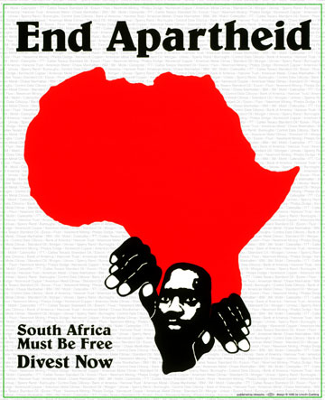
International Support
How should the international community react to Apartheid?

Slide 14
International Boycott
The United Nations began a boycott of South Africa in 1962.
In the ‘80s and ‘90s, attention to the Apartheid regime increased, and people began a boycott of S. African, goods and companies doing business with South Africa.
Moral Pressure: S.A. wealth created from Apartheid system
Economic Pressure: losing business to boycott.

Slide 15
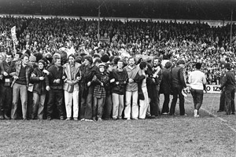
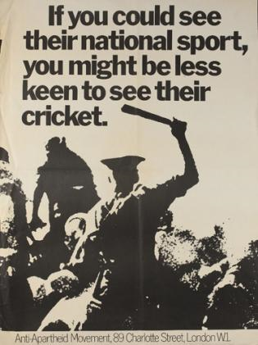
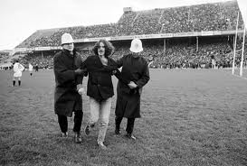
Boycott of S.A. Sports

Slide 16
Transition of Power
1990-1994
Mandela was released from prison in 1990, and resumed his campaign to end apartheid, which began being slowly dismantled.
By 1994, South Africa was preparing to have all-race elections.
Nelson Mandela was elected the first African president of South Africa in 1994

Slide 17
Pyrrhic Victory
Apartheid was ended and political power was transferred to the ANC.
But, this did not mean that all of the problems were solved…

Slide 18
Economic Power
The central bank was made autonomous (not under control of the ANC government)
  Prevented redistribution of land
Constitution to protect private property
Last Minute GATT agreement: Illegal to subsidize auto plants and textile factories
No free AIDS medicine: violates intellectual property rights.
IMF agreements: -- Wage restraint – can’t raise wages
    Service Debts from Apartheid era: No money for housing projects, free electricity and water projects.

Slide 19
Trickle Down?
Rather than redistribute wealth, the ANC decided on a policy of pursuing foreign investors who would create new wealth, which would trickle down to the poor.

Slide 20
Since 1994, the year the ANC took power, th enumber of people living on less than $1 a day had doubled from 2 million to 4 million in 2006.
Between 1991 and 2002, the unemployment fro black South Africns doubled (23% - 48%)
Of South Africa’s 35 million black citizens, only five thousand earn more than $60,000/year. The number of whites in the same income bracket is 20x higher.
The ANC has built 1.8 million homes since 1994. At the same time, 2 million people became homeless.
1 million people were evicted from their farms in the first decade of democracy.
The number of shack dwellers has risen by 50%. In 2006, more than ¼ of South Africans lived in shacks located in shantytowns with no running water.

