Slide 1
War Industries Board
Created July, 1917 to determine what materials manufacturers could use and what they could or could not make.
~500 war service committees to oversee and represent industries. (From corsets to steel).
  Price Fixing – US Grain Corp.
  Food Administration – H. Hoover
  Fuel Administration
Labor unions flourished during the war because of high demand for labor.

Slide 2
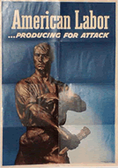
National War Labor Board
NWLB
To mediate disputes, recognize fair wages and hours, collective bargaining.
War Labor Policies Board
  Set standards for federal employees

Slide 3
World War and the death of Progressive Party
By 1916, Progressives became extremely committed to the defense of national honor, nationalism, and opposition to Wilson. But, imperialism and militarism replaced old liberal formulas of protest, and within a year, the party was dead.
War was justified with progressive rhetoric and on progressive terms.
  Discredited progressive language – morals and ideals
  Guaranteed that anti-war reactions would be anti-progressive.

Slide 4
Woodrow Wilson
Insists on “open door” → to make the world safe for democracy.
1919 – endorses women’s suffrage as vital for winning the war.
Obsessive fear of disloyalty:
  Espionage Act
  Sedition Act
  Selective Service Act
  Trading with the Enemy Act
  Alien Enemies Act
  Alien Act

Slide 5
Wilson in Versailles
Goes to Paris (no nationalistic aims)
Brings only Democrats with him to the conference.
Negotiates the 14 Points (Territorial issues, Self Determination, League of Nations…)
14th Point: League of Nations – international body to keep the peace & avoid a second world war.
  The US fails to join the League of Nations

Slide 6
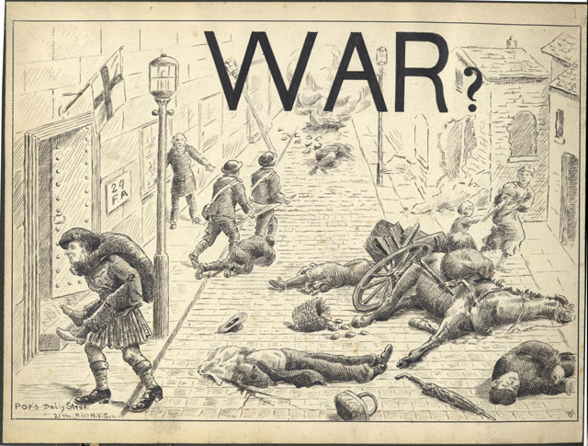
WWI killed 10 million in battle
2 million died of hunger related to war

Slide 7
Roaring ‘20s
Rebellion and Reaction
Harlem Renaissance
Jazz
Prohibition
Political Radicalism
New Feminism
New Economic Heights & Deregulation

Slide 8
1920s
Culture wars
Isolation
v.
pluralismnism
Cosmopolitanism
v.
provincialism
Rrsurgence of the KKK
Red Scare
Prohibition
Great Migration
Women’s Sufferage
Economic
Deregulation

Slide 9
Deregulation
The progressive movement to regulate the economy and break up trusts was over.
WWI expansion of the government in the economy rolled back.
Coolidge: “the chief business of the American People is business,” if government kept its hands out of the economy, business would prosper.

Slide 10
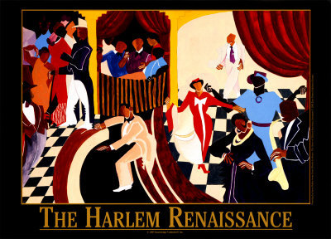

Slide 11
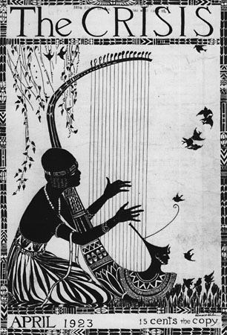
Harlem Renaissance
1920s Harlem was 70% black-owned.
Many African Americans had been moving North as part of the Great Migration during and after WWI, during which 750,000 blacks left the South.
A new interest in Africa, and creating an identity based on cultural roots was developing in the USA, along with a new sense of pride in black culture.
NAACP moves offices to New York, and DuBois becomes an editor of their journal, The Crisis. The journal sponsored artists of the Harlem Renaissance such as Langston Hughes.

Slide 12
With many economic opportunities closed to them, creative expression was one viable option →flourishing of music and arts.
Harlem attracted a large number of educated and talented African Americans and became a center of cultural and artistic expression, transforming “social disillusionment to race pride.”
    Alain Locke

Slide 13
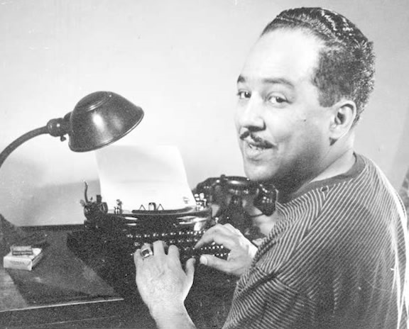
Langston Hughes

Slide 14
I've known rivers:
I've known rivers ancient as the world and older than the flow of human blood in human veins.
My soul has grown deep like the rivers.
I bathed in the Euphrates when dawns were young.
I built my hut near the Congo and it lulled me to sleep.
I looked upon the Nile and raised the pyramids above it.
I heard the singing of the Mississippi when Abe Lincoln
went down to New Orleans, and I've seen its muddy bosom turn all golden in the sunset.
I've known rivers:
Ancient, dusky rivers.
My soul has grown deep like the rivers.
--Langston Hughes, 1920

Slide 15
‎"If we must die, let it not be like hogs
Hunted and penned in an inglorious spot,
While round us bark the mad and hungry dogs,
Making their mock at our accursed lot.
If we must die, O let us nobly die,
......So that our precious blood may not be shed
In vain; then even the monsters we defy
Shall be constrained to honor us though dead!
O kinsmen we must meet the common foe!
Though far outnumbered let us show us brave,
And for their thousand blows deal one deathblow!
What though before us lies the open grave?
Like men we'll face the murderous, cowardly pack,
Pressed to the wall, dying, but fighting back!“
-- Claude McKay, 1919
Notes:
Written in response to the Red Scare.

Slide 16
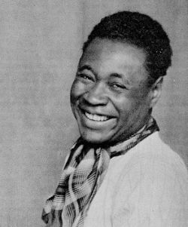
Claude McKay

Slide 17
Jazz
Cotton Club – famous Harlem venue: Served only white customers and had a jungle motif with plantation decoration.
Ragtime – takes military march and changes the time.
Piano music also popular because of a growing number of people who have pianos in their homes in the ’20s.
1st Blues album – Jellyroll Morton – sells 75,000 copies!

Slide 18
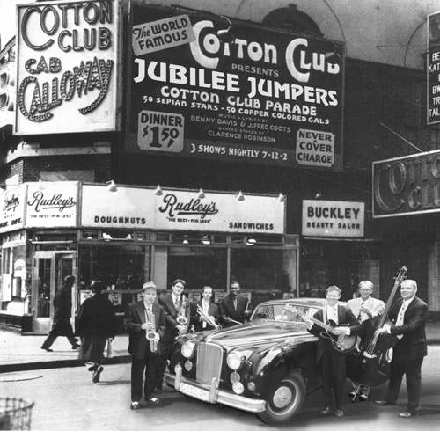

Slide 19
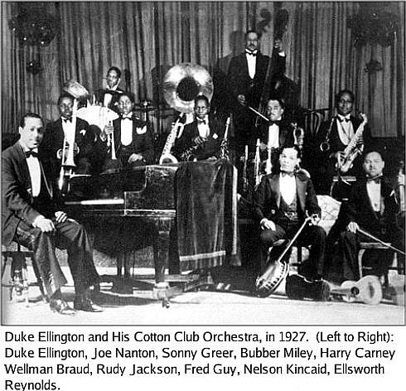

Slide 20
Louis Armstrong
Arrested in 1913 at age 19 for shooting into the air
  Put in a boy’s home where he played in a marching band
  Individualistic emphasis in music
  Armstrong as the first jazz “rock star”

Slide 21
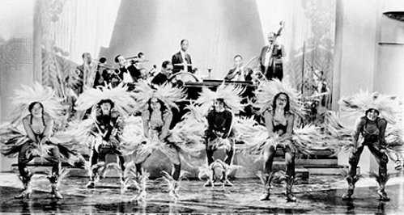
Duke Ellington
Got his start at the Cotton Club playing big band music
By 1931, because he was so popular, he was invited to visit the white house!

Slide 22
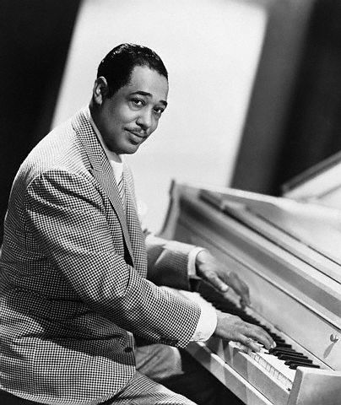

Slide 23
Prohibition and Bootlegging
In 1919, Congress passed the 18th Amendment to the constitution, outlawing the sale and manufacture of alcohol in the United States. The law was set to take effect in January of 1920. (It was repealed in 1933).
Reaction: In Detroit before prohibition, there had been 2,334 liquor serving establishments; after prohibition, it had 15,000!

Slide 24
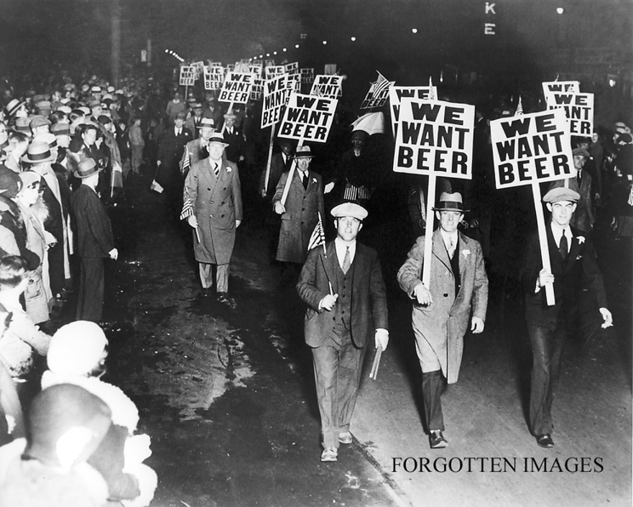

Slide 25
What sort of social pressures led to prohibition?
How might these be related to other trends going on in the ’20s, such as the Red Scare, anti-immigrant attitudes, and a resurgent KKK?

Slide 26
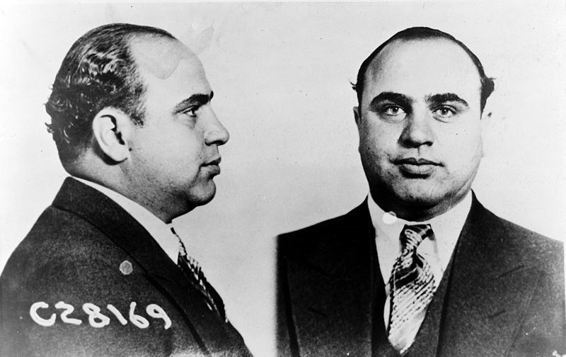
Al Capone
Made fortunes running illegal liquor during Prohibition (among other illegal activities). Eventually, he was caught and sent to prison for tax evasion.

Slide 27
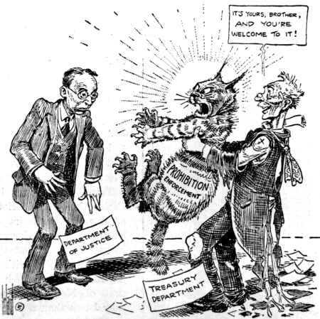

Slide 28
Political Radicalism
Resurgent KKK (now anti-Catholic and anti-Jewish)
Americanism being defined as protestant, Anglo culture.
Communism and Anti-Communism
4,000 communists were arrested in the Palmer Raids of 1920, and by 1928, communists were on the ballot in 34 states.
Rejection of Progressivism

Slide 29
Sacco and Vanzetti
Spring of 1920, an anarchist typesetter, Andrea Salsedo was arrested and helf for 14 weeks at FBI offices on the 14th floor of Park Row Building in New York.
  He was denied council and contact to the outside (denial of 6th amendment rights)
  His body was found crushed from a jump the FBI said was a suicide.

Slide 30
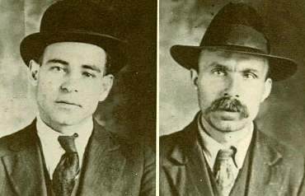

Slide 31
As a result, other anarchists, including Sacco and Vanzetti decided to carry guns
They were blamed for a robbery/murder at a shoe factory and sentenced to death.
The trial was poorly conducted, and it was widely perceived that they were executed for being anarchists, not for being guilty of the crime.

Slide 32
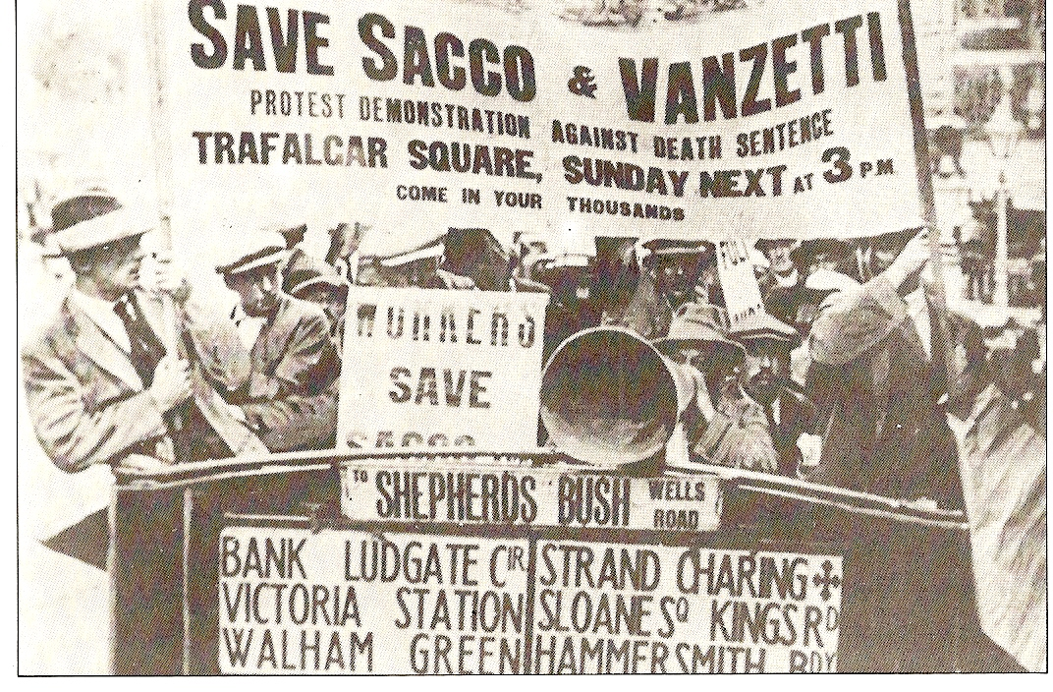

Slide 34
Rough Draft: Intro Paragraph
The 1920’s in the United States was a time characterized by economic prosperity, political fundamentalism, a resurgence of the KKK, and a strong anti-immigrant and anti-communist mood. During this time, the national identity was being defined as a distinctly white and protestant one, and at the same time, movements like the Harlem Renaissance were creating a new African-American identity in art, music and literature. The 1920s was also defined by cultural tension, rebellion and reaction. The Scopes “monkey” trial illustrates some of the period’s cultural tension by putting religion on trial and making a media spectacle out of protestant and secular parts of society.

Slide 35
Rough Draft: Outline
Culture in the 20s: political fundamentalism
  Red Scare – anti-communism/anti foreigner
  Andrew Mellon – conservative economics
Conservative values:
  Resurgence of the KKK, anti immigrant mood, Red Scare
  Prohibition – should we legislate morality?
Scopes Trial:
  Issue: What happened?
  Cast of Characters: Who was involved?
  The Trial: events at the trial…
  Significance: religion on trial, role of eugenics, religion in schools, defining mainstream culture…
Verdict: Who won, why?
  How is the Scopes trial seen today?
Conclusion…

