Slide 1
FALL of the SOVIET EMPIRE
End of the Cold War
Arms Race
Ceausescu in Romania
Bulgaria

Slide 2
Loss of Legitimacy
By stating that he wouldn’t intervene militarily in the internal affairs of satellite states, Gorbechev undermined the legitimacy of governments of satellite states.

Slide 3
The Dictatorship of Nicolae Ceausescu
Ceausescu was critical of Moscow, which won him praise in the West, and which had the consequence that the West was willing to ignore his domestic crimes.
  For example, eight months after arresting striking miners and executing their leaders, he was a guest of Jimmy Carter in the US.
He made great efforts to pay off foreign debt and even sent athletes to compete in the Olympics in Los Angeles.

Slide 4
Debt Payment
Ceausescu embarked on a campaign to pay off all debts to Western creditors. To do this, he set about exporting every available commodity.
Romanians were forced to use 40 watt bulbs to export more electricity to Germany and Italy.
Meat, sugar, eggs, flour, butter were strictly rationed.
Obligatory “volunteer” labor on Sundays and Holidays was introduced to increase production.

Slide 5
Oppressive laws
Ceausescu wanted to increase population, so he passed a law that outlawed abortions for women under 40 with fewer than 4 children.
  Doctors in districts with declining birth rates had their salaries cut
  Between 1966 and 1988, at least ten thousand women died from illegal abortions performed under dangerous conditions.
    The population did not increase.
  By 1989, there were over 100,000 institutionalized children, and the death rate for children was the highest in Europe.

Slide 6
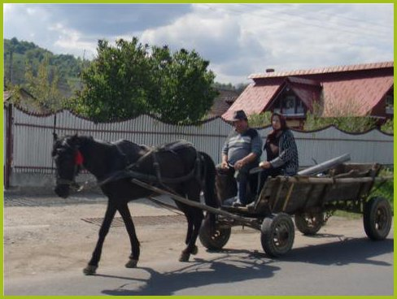
Horses?
To reduce gas usage, a program to breed horses was begun in 1986. Horse drawn carts became the main means of transportation and crops were harvested by hand.

Slide 7
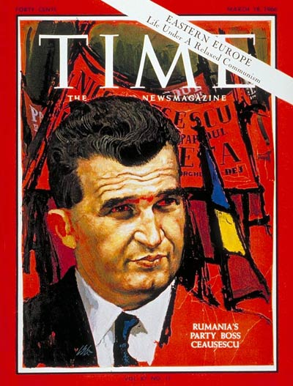
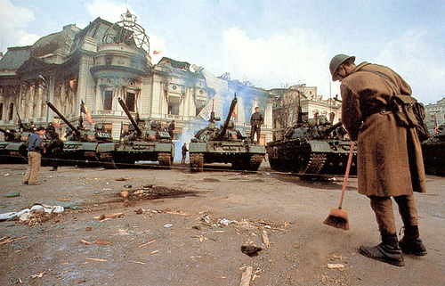
Do not think.
· If you think, do not talk.
· If you talk, do not write.
· If you write, do not sign (your name).
· If you sign, do not be surprised.

Slide 8
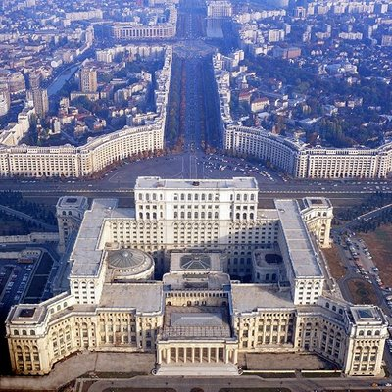
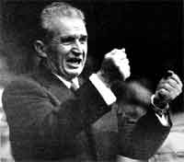
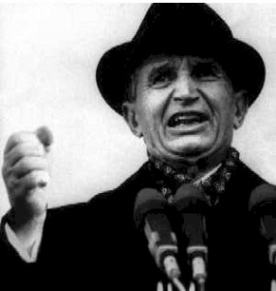
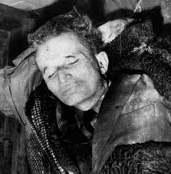

Slide 9
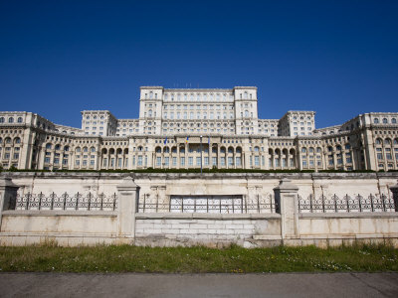

Slide 10
Another Bad Idea
Increase Production: Ceausescu thought he might be able to increase control over the population and increase agricultural production by reorganizing rural communities.
His crazy idea of how to do this was to raze half of the country’s 13,000 villages and transfer residents to “agro-towns”
Luckily, he was deposed and killed before this could be fully implemented.

Slide 11
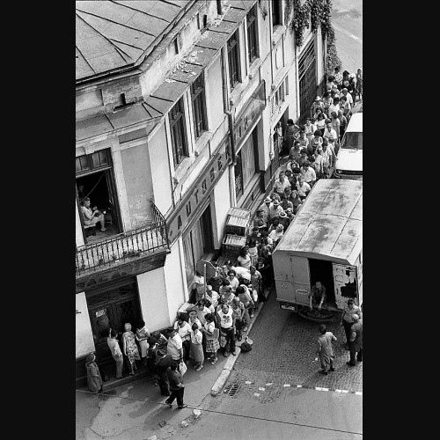

Slide 12
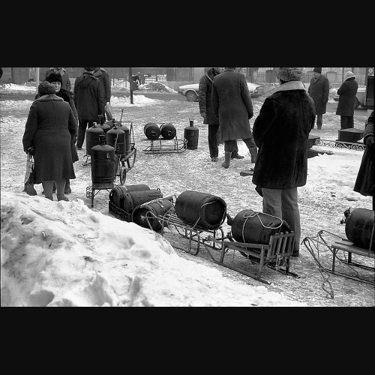

Slide 14
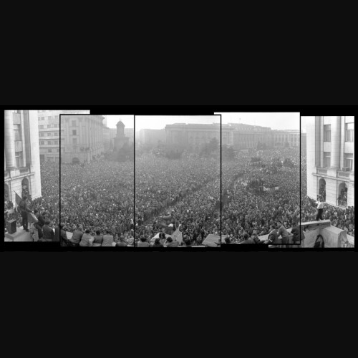
Demonstrations in 1989: When people learned Ceausescu had fled, over a million people came out to demonstrate in central Bucharest.

