Slide 1
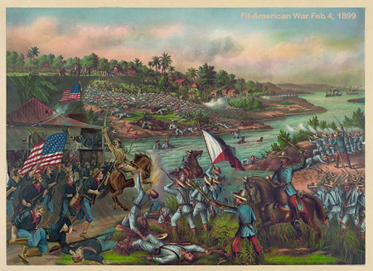

Slide 2
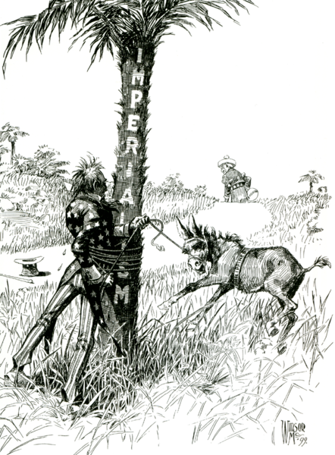
Spain
Philippines
Uncle Sam

Slide 3
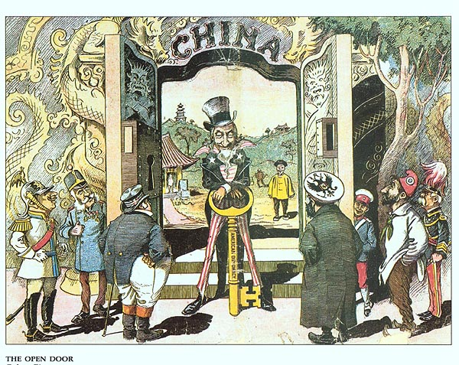
Notes:
The Chinese in the picture are portrayed as clearly happy that their friend Uncle Sam is protecting them from these other foreigners who wish to dominate their country. But there is a racist assumption in this picture; that being that the U.S. should be the key holder for these people who are to weak to do it themselves (a Social Darwinist assumption). Of course, when the Chinese did fight back against foreign influence (as in the Boxer Rebellion), the Chinese were called savages.

Slide 4
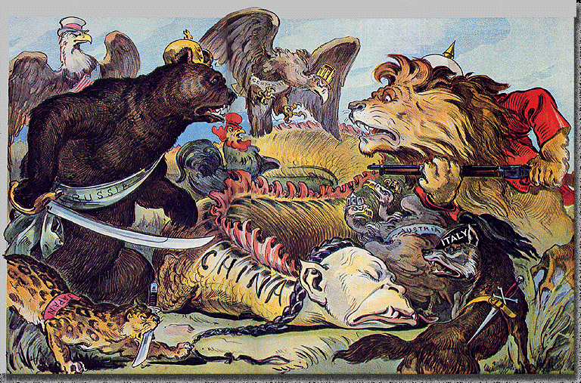

Slide 5
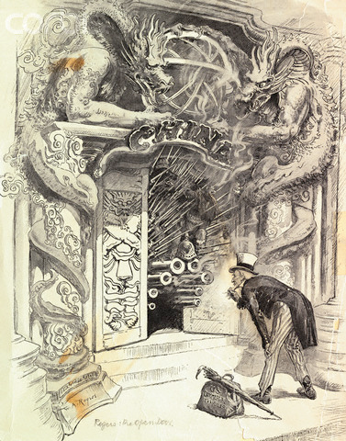

Slide 6
1900 - 1910
1900-1901:
  US Population: 75.9 million
  NY population: 3.4 million
  100 immigrants per hour coming through Ellis Island
  There were 8000 cars, 10 million bicycles, and 18 million working horses.
  First major oil well at Spindletop produces 80-100,000 barrels per day.

Slide 7
1900-1910
1903:
  1st car drives across the United States
52 days!
1904:
  1000 + cases of typhoid linked to Typhoid Mary
1905:
  IWW founded by Eugene Debs and Mother Jones
1908:
  Model T production begun (one sells for $850)

Slide 8
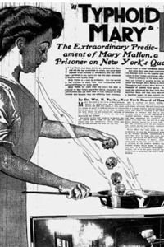
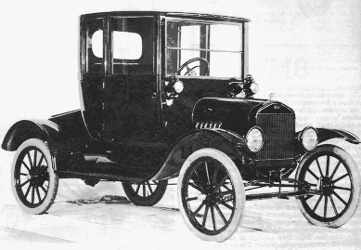

Slide 9
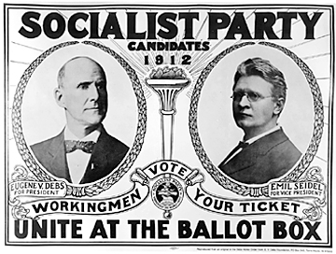
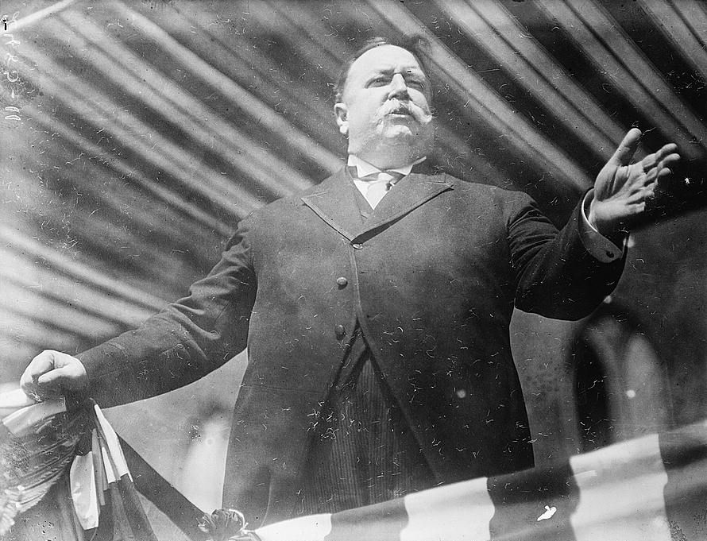
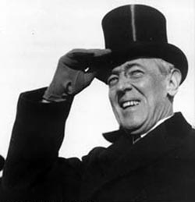
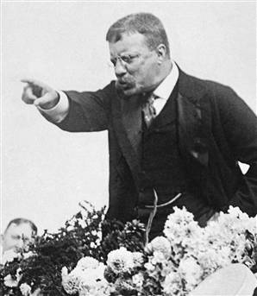
1912 Election

Slide 10
